Slide 1

VAST 2016 MINI CHALLENGE 2
Team Pocket Aces: Parth Keyur Gawande
Nikhil Satish Suryawanshi
Sarthak Rajendra Bora

Slide 2

AGENDA
Problem Statement
Dataset Description
Data Visualization of Prox data
Employee Movements and Prox Card Reading Data
Building sensor data investigation
Anomaly Detection
Causal Relationship

Slide 3

PROBLEM STATEMENT
The new GAStech building designed for energy efficiency, is equipped with HVAC zones monitored by sensors reporting various parameters, including hazium levels. Additionally, new security procedures involving prox cards have been implemented, and a robotic mail delivery system named Rosie with a mobile prox sensor operates within the building to analyze two weeks of static data (May 31 to June 13, 2016)
Goal: 1) Visually analyze the typical patterns in prox card data 2) Visualize a typical day of a GasTech Employee 3) Get key insights on the patterns of building data 4) Investigate the sensor readings and estimate correlation 5) Find out any key anomalies or unusual behaviour in sensor readings and employees 6) Investigate causal relationships between building data and employee activity

Slide 4
DATASET DESCRIPTION
A building layout for the GAStech offices, including the maps of the prox zones and the HVAC zones
A current list of employees, roles, and office assignments
A description of the data formats and fields provided
Proximity sensor data for each of the prox zone regions
Proximity sensor data from Rosie the mobile robot
HVAC sensor readings and status information from each of the building’s HVAC zones
Hazium readings from four sensors.

Slide 5
EMPLOYEE MOVEMENTS AND PROX CARD READING DATA

Slide 6
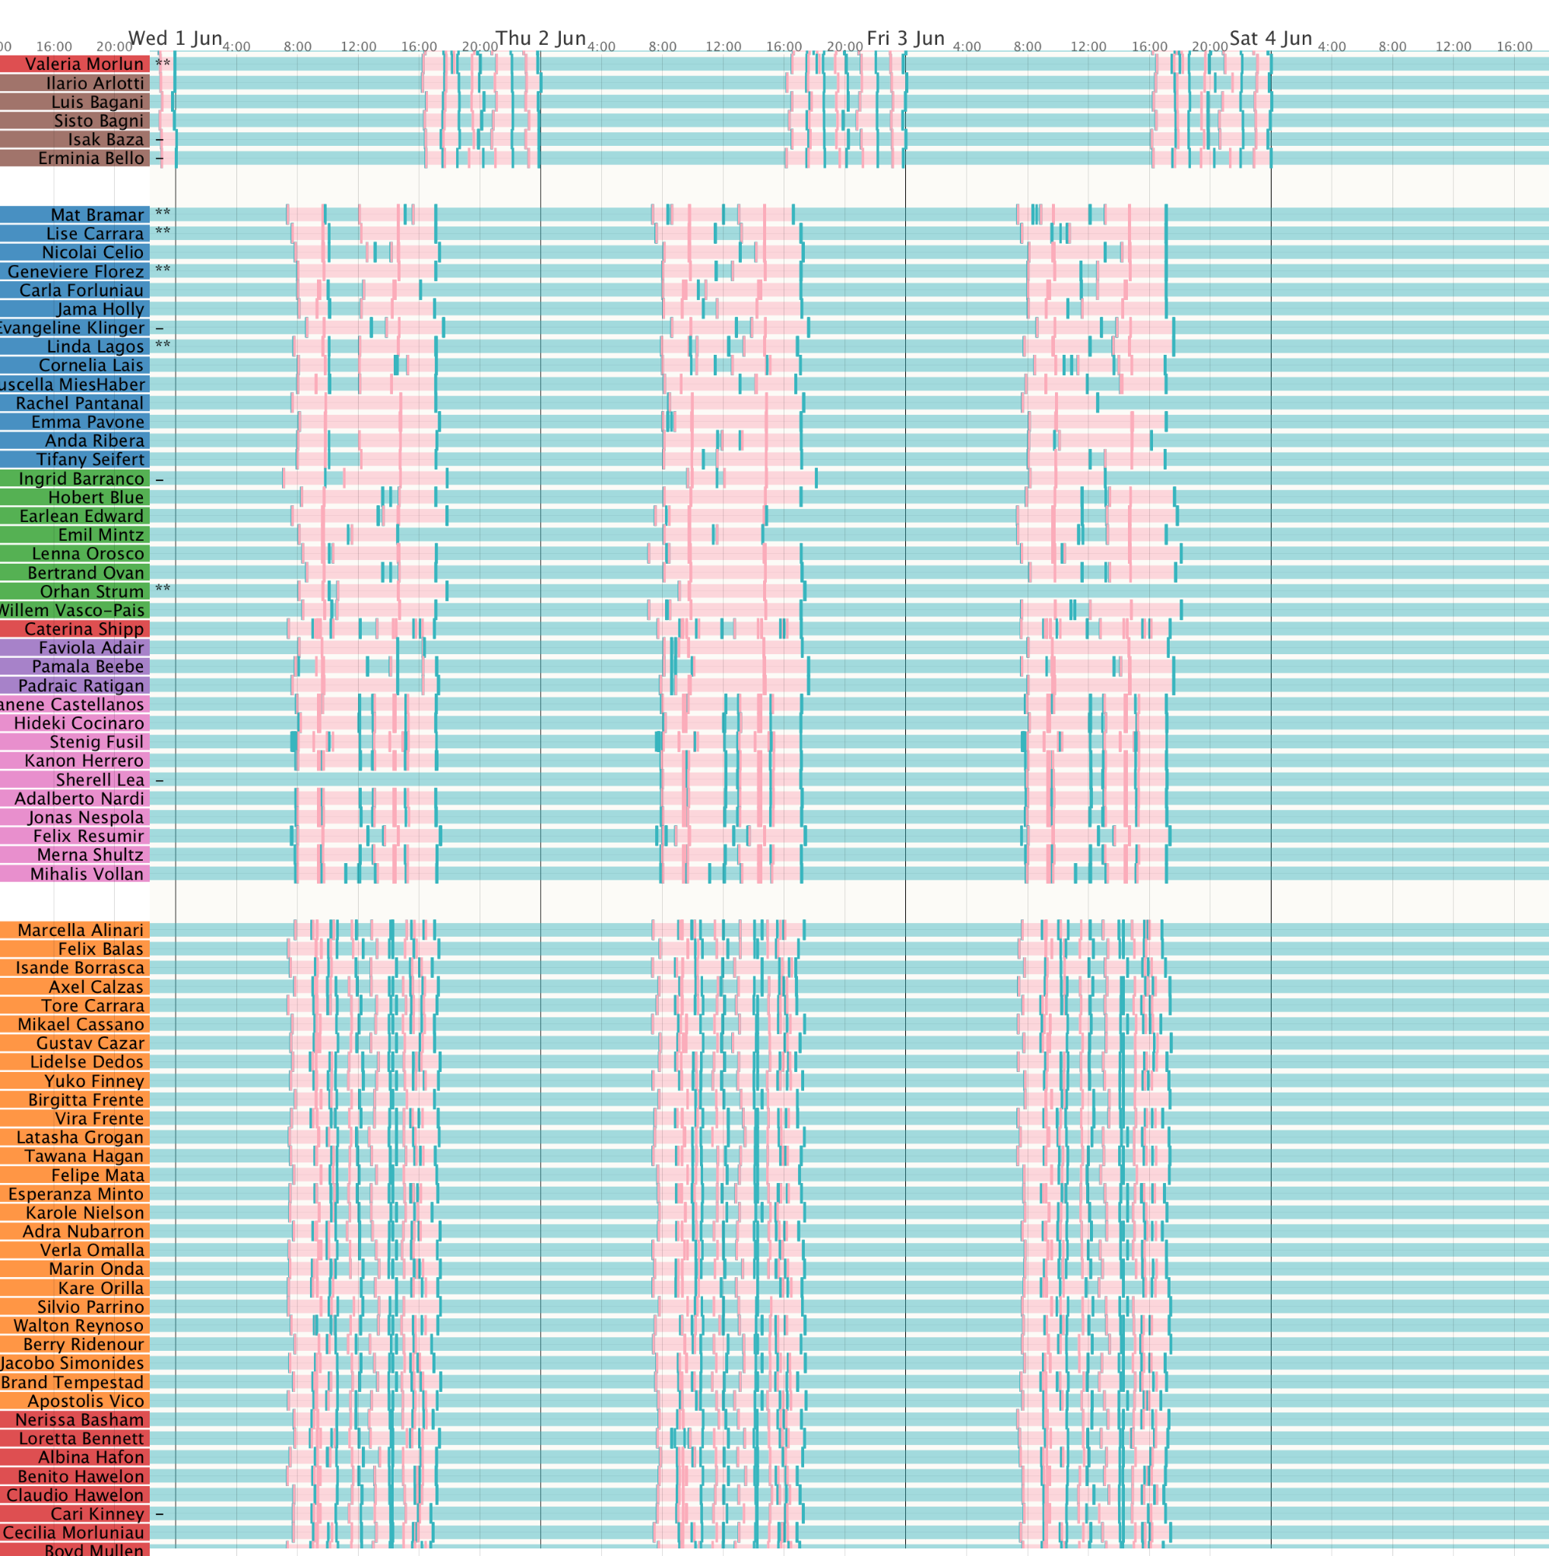
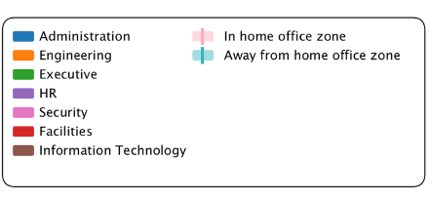
PROX CARD ENTRY PATTERNS AND TYPICAL WORKING HOURS
Workday Routines:
Employees generally enter at 8 am and leave at 5pm on weekdays, with minimal activity on weekends.
Shift Diversity:
Notable shifts include 4 pm to midnight and midnight to 8 am reflecting roles like facilities and IT.

Slide 7
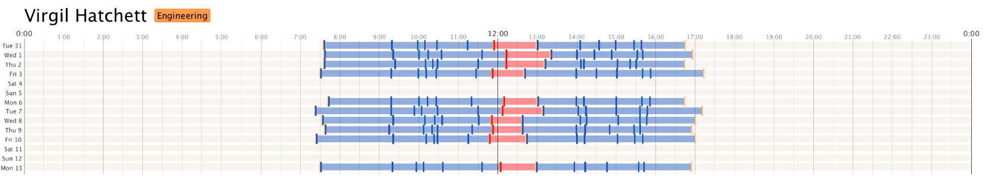
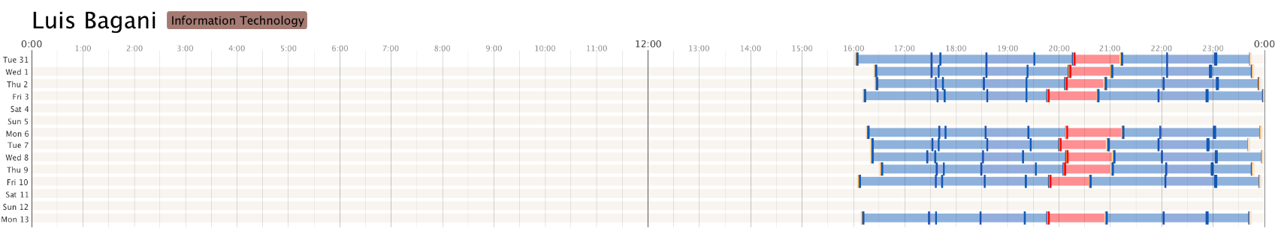
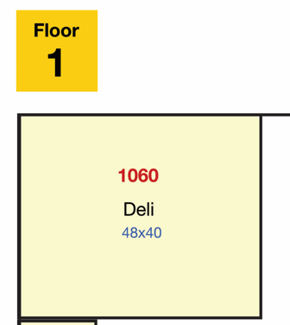
Figures depict the employee Virgil Hatchett’s and Luis Bagani typical deli-eating day which work at different shift timings Most employees (especially in Engineering, Facilities and IT) have their lunch break in the deli.

Slide 8
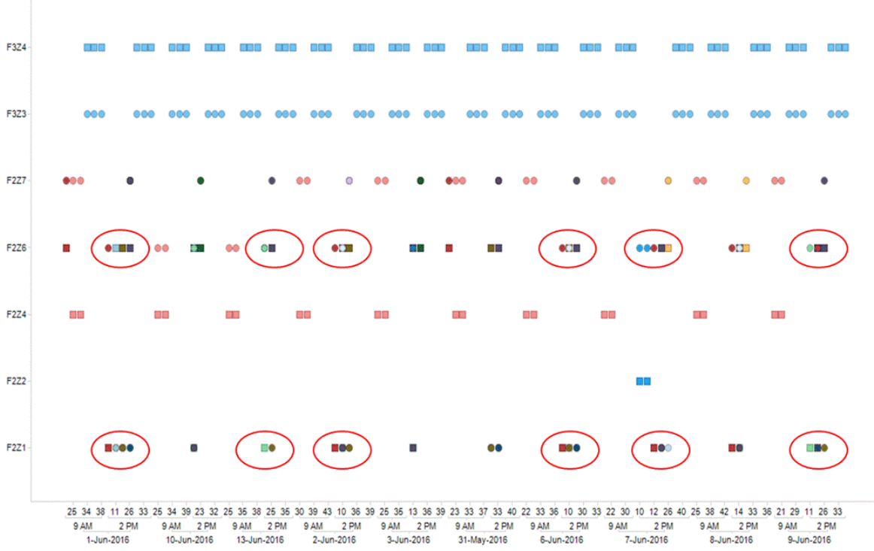
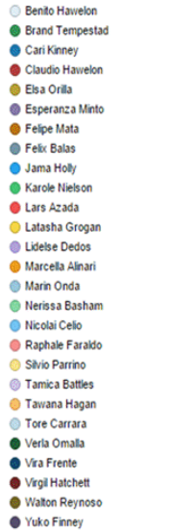
PROXIMITY CARD AND ROSIE SCAN CONFLICTS
Plot details conflicts with x-axis representing time and y-axis showing locations, Colors denote employees, shapes indicate scan types (square for rosie, circle for proximity card)
Marin Onda, Walton Reynoso, and Yuko Finney consistently leave proximity cards in their offices (highlighted points).
Nicoloi Cello and Raphale Faraldo exhibit discrepancies in check-in locations, likely due to mobile robot scans overlapping adjacent zones.

Slide 9
BUILDING SENSOR DATA

Slide 10
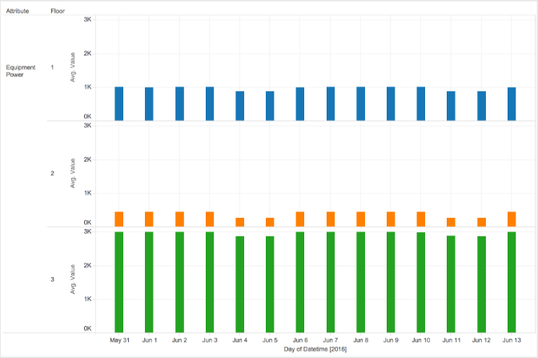
POWER CONSUMPTION
It is remarkable that the energy consumption in the third floor is much higher that in the other floors . Also this energy consumption remains high in the weekends. We can explain this because a zone in the third floor is under construction and the construction equipment consumes a lot of energy. Or maybe there is an area that is being used for something else.

Slide 11
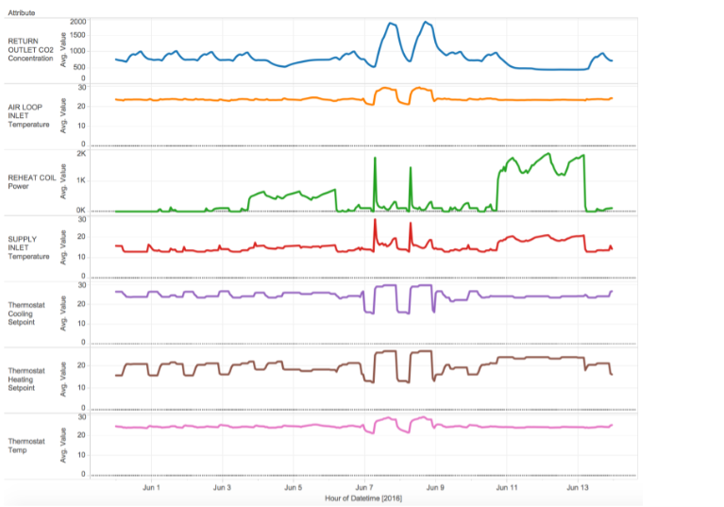
We can show a direct dependency between the average Return Outlet CO2 peaks for the entire building with the following attributes:
Air Loop Inlet Temperature
Reheat Coil Power
Supply Inlet Temperature.
Thermostat Cooling Setpoint
Thermostat Heating Setpoint
Thermostat Temp

Slide 12
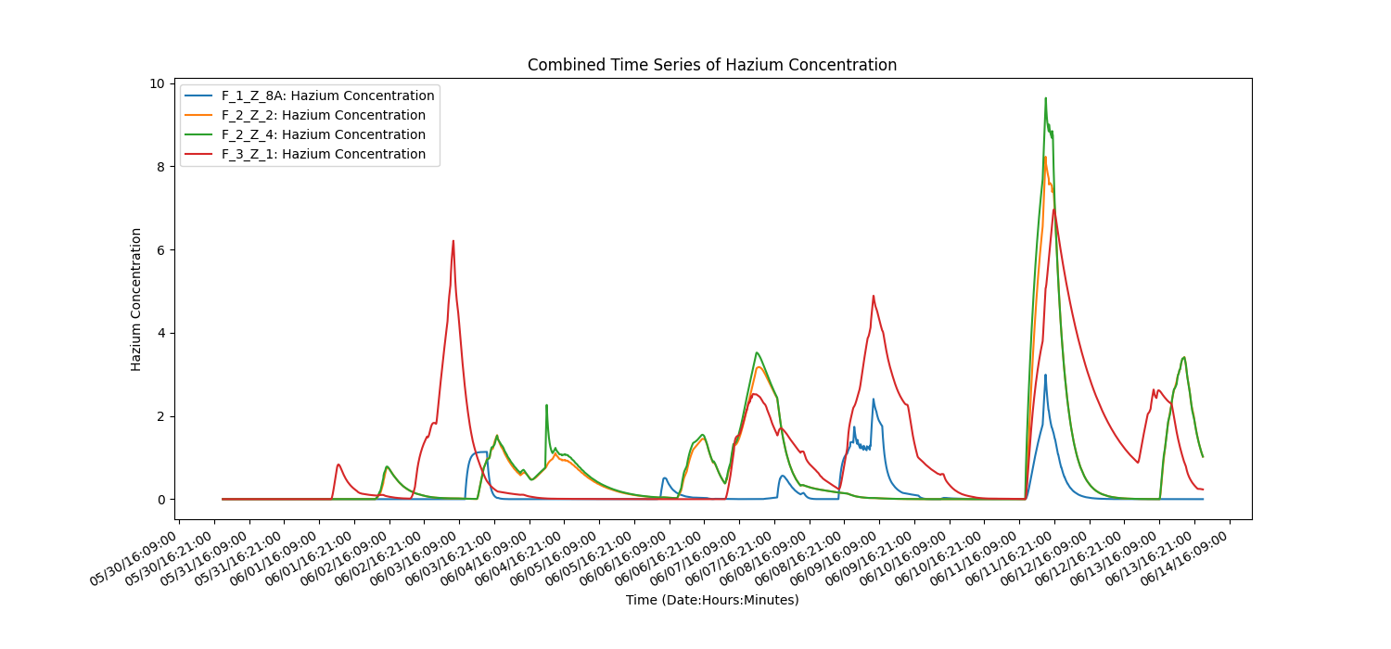
HAZIUM SENSOR READING
Notable peaks on Friday 3rd (Floor 3), Tuesday 7th (Floors 2 and 3), Thursday 9th (Floors 1 and 3), Saturday 11th (All floors).
Floor 3 consistently most affected, suggesting a potential source or gas characteristic.

Slide 13
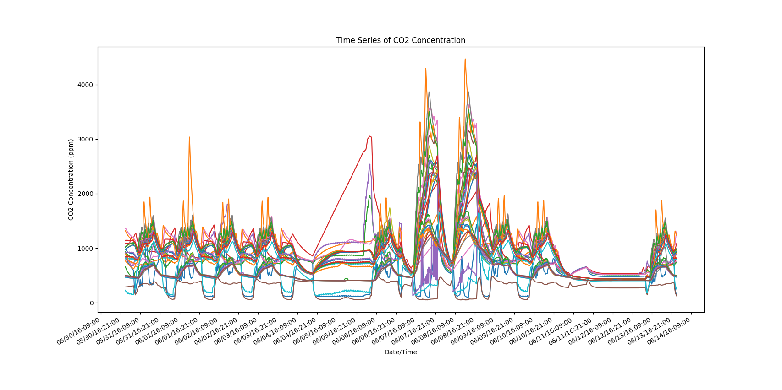
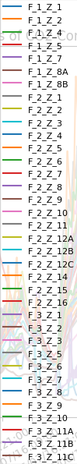
CO2 SENSOR READING
Carbon dioxide sensor readings. Scaled by +- 10 standard deviations from the mean reading. Coloured by floor of sensor
Two notable peaks in Carbon Dioxide levels are observed during Wednesday 7th June and Thursday 8th across all floors. This coincides with a major event evident in most sensor readings over these two days.

Slide 14
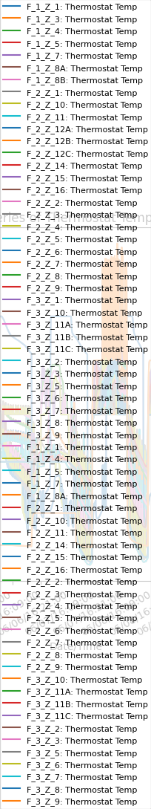
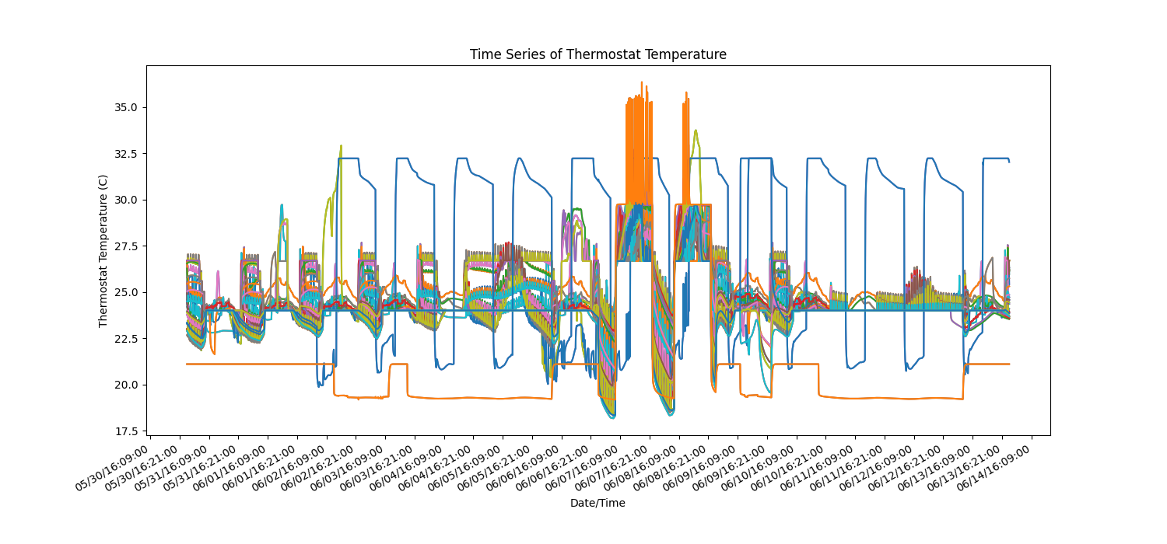
THERMOSTAT TEMPERATURE READING
This figure shows the Thermostat Temperature for all energy zones for all days indicating values are higher than normal for June 7-8.

Slide 15
ANOMALY AND CAUSAL RELATIONSHIP

Slide 16
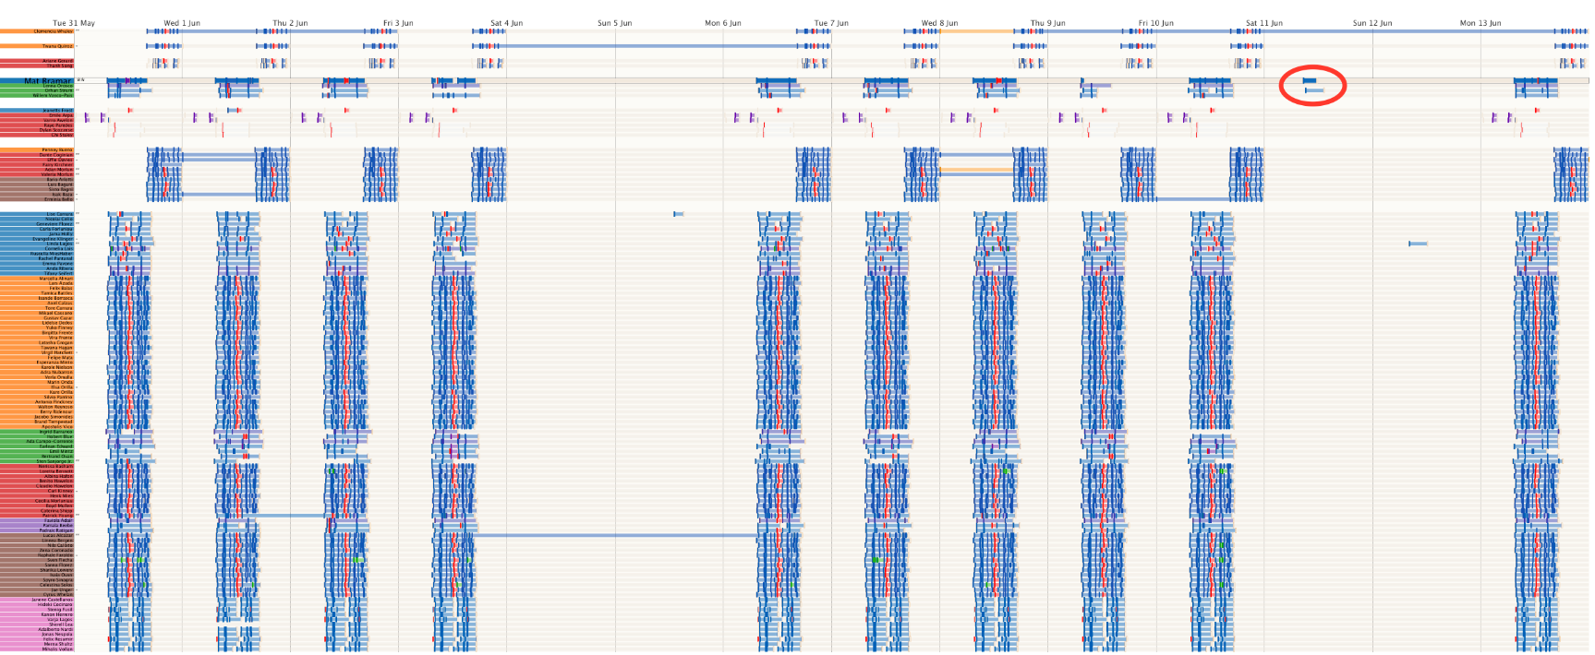
WEEKEND BEHAVIOUR OF BRAMAR AND STRUM
There are two exceptions evident from the prox card timelines where card entries occur during weekend periods. Of particular note are the entries using the cards of Mat Bramar and Orhan Strum on Saturday 11th June between the periods of 8:30-11:30am (Bramar) and 9:00-13:00 (Strum)). This is notable because not only do they intersect in time and space but they also occur just before the only weekend outbreak of Hazium gas

Slide 17
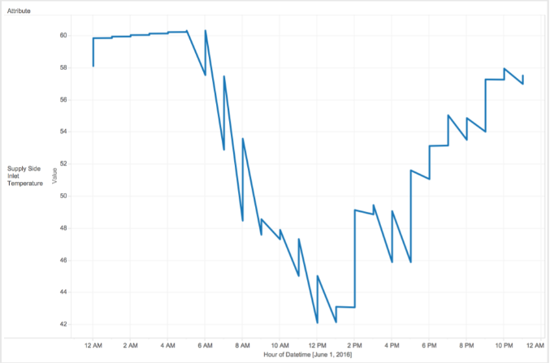
ANOMALY IN SUPPLY SIDE INLET TEMPERATURE
The registered water temperature entering the boiler has its highest value during night hours and the lowest ones in the middle of the day. This makes no sense because solar energy is at its highest point at noon . This can be caused by a bad configuration in the inner clock of the sensor. This anomaly is repeated every day

Slide 18
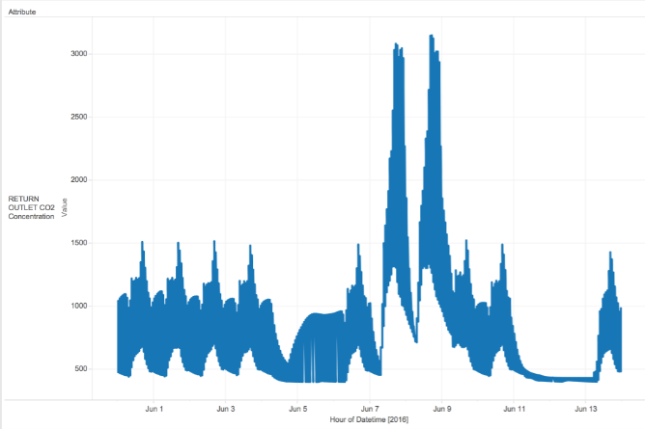
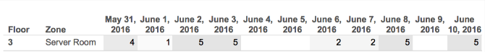
RETURN OUTLET CO2
CO2 Peaks in Server Room:
Figure shows two CO2 concentration peaks on June 7 and 8 in the 3rd-floor server room.
Impact on Employee Attendance:
Figure indicates no employee presence in the server room on June 9, possibly due to the elevated CO2 levels on the preceding days.
Unusual Absence Pattern:
Unusual as the previous week had employee presence, suggesting a potential negative impact of CO2 on attendance during the mentioned days.

Slide 19
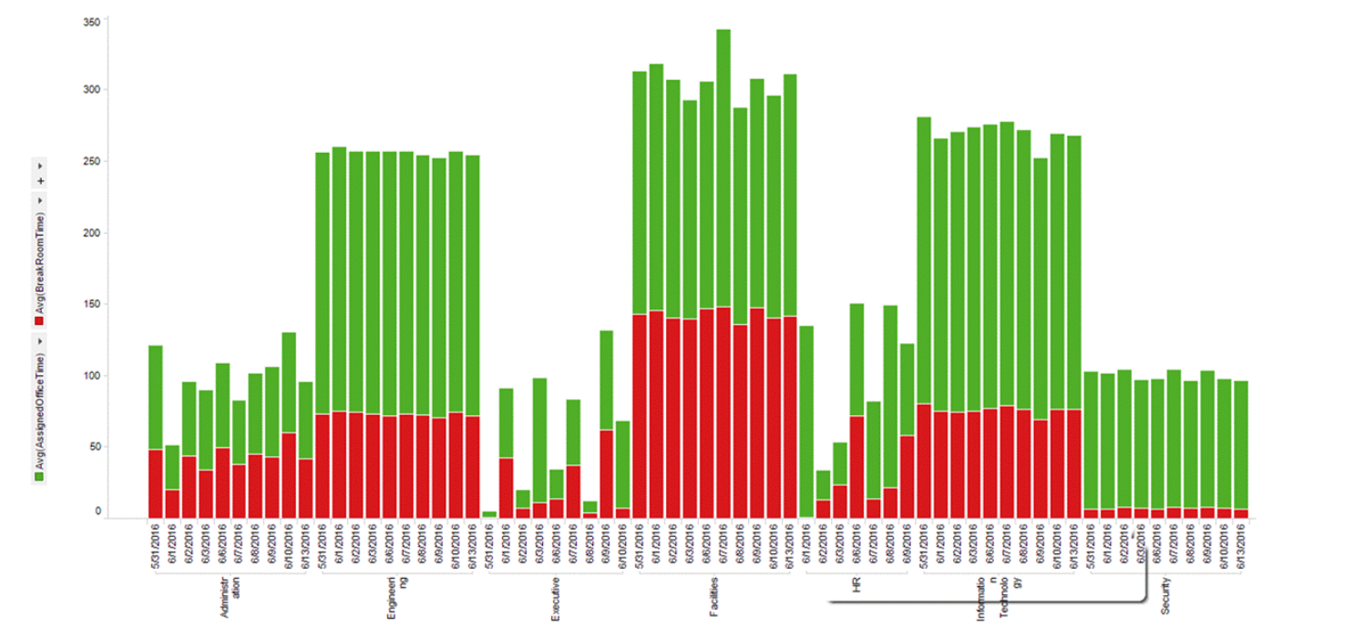
EMPLOYEE TIME ALLOCATION IN OFFICES AND BREAK ROOMS
This figure shows the time spent by employees in a department either in their assigned office or in the break room (but not in any other room). Employees of the Executive group seem to spend much less time in the office on June 8th relative to normal. As expected Facilities group worked noticeably above their average length of time on the 7th to solve the temperature issue.

Slide 20
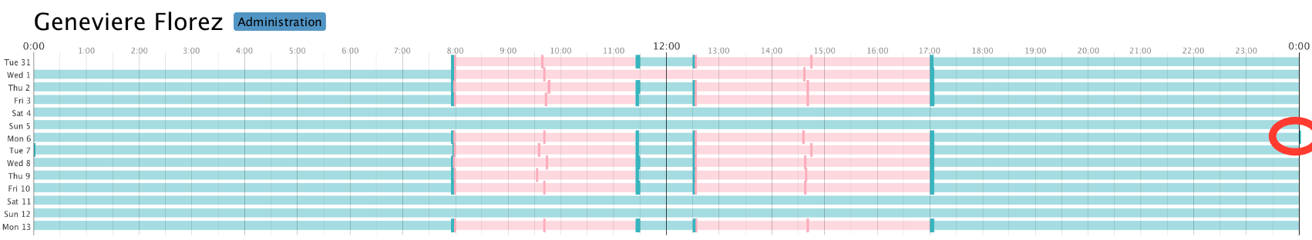
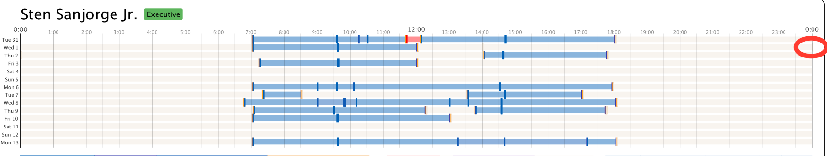
ANOMALIES IN PROX CARD ENTRIES
Geneviere Florez had Five card reissues, posing a security concern given her role.
Unusual midnight entry on Monday 6th, preceding a significant anomaly, raises suspicion of potential unauthorized access.
Geneviere's prox card carelessness may pose security risks, emphasizing the need for heightened monitoring and security measures.
CEO Sten Sanjorge Jr works long hours but usually between 7am and 6pm. However unusually his card shows an entry around midnight Wednesday 1st/Thursday 2nd June. This is unexpected and anomalous as there appear to be no other prox card entries in the 12 hours either before or after this entry.

Slide 21
FUTURE SCOPE
Utilize machine learning for HVAC system optimization, ensuring energy efficiency and employee comfort.
Explore the feasibility of expanding sensor networks, particularly hazium sensors, for comprehensive environmental monitoring and safety.
Use association rule mining to get behaviour of different sensors and how they correlate with each other

